Slide 1
Applications of Context for Artificial Intelligence
Quentin Truong

Slide 2
Basic Knowledge Problem
Ask a robot to bring you a cup
It doesn't know how to find, pick up, transport etc.
Might break the cup or break itself
Must be told how to do all of this
We consider this knowledge trivial
Understand how to hold cups, where cups are located, etc.
Humans use this contextual knowledge of objects
But robots don't know
Must obtain this knowledge somehow

Slide 3
Basic Knowledge Problem
DARPA Robot Challenge
Robots can't open doors or walk really
https://youtu.be/g0TaYhjpOfo?t=26s
What we consider to be basic is actually fairly difficult
It's not simple to open a door or walk

Slide 4
Context Filtering Problem
Humans can filter information
Humans often have some idea of what is likely to work and what is unlikely to work
Understand what information is relevant and what variables should be changed
Can use this to filter out poor solutions
Because search-space is smaller, humans can experimentally figure out new solutions to new problems
Machines don't have the knowledge to be capable of filtering
Machines don't know what is relevant and what is not
Must resort to brute-force search oftentimes
Search-space is likely to be intractably large
Will never find the solution if it cannot reduce the search-space

Slide 5
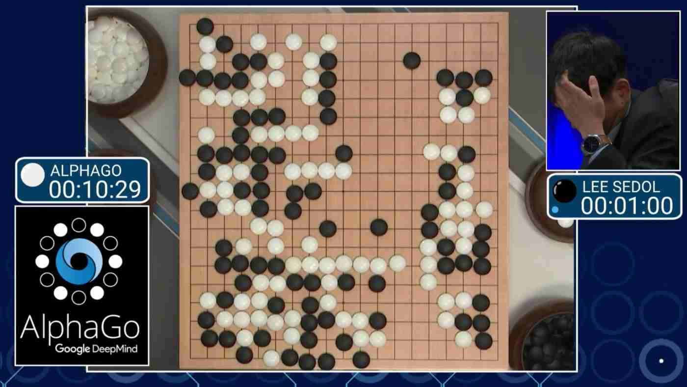
Search Space
AlphaGo
Search space intractable
Must reduce search space
Humans use intuition to reduce search space

Slide 6
Object Relationships Problem
Humans understand relationships between objects
We know how nouns relate to other verbs
But the machine does not know these sorts of things
Machines don't understand relationships between objects
You can dethrone a king, but you can't really 'harvest' a king
Machine doesn't know that you should not eat a table
Machines in unstructured environments perform terribly

Slide 7
Object Relationship Solution
Researchers at BYU download Wikipedia
Teach machine relationships between nouns and verbs
Use Wikipedia as a source of up-to-date text
Apply math and figure out relationships between words in the text downloaded from Wikipedia
So now machine knows how nouns relate to other verbs

Slide 8
Results of the solution
BYU Researchers improve performance
For an unstructured text game where machines have to respond to textual input, improved performance on 12/16 games
This improvement was from understanding relationships between objects alone
Other improvements could include grammar, speaking conventions, etc

Slide 9
Future Applications
Basic Knowledge
Need machines to be capable of a variety of tasks if integrated in consumer environment
Must understand how to not break things
Must not break itself
Context Filtering
AI figure out solutions for unseen problems
Performance in unstructured environments
Object Relationship
Easy, convenient format to communicate to machines
NLP

Slide 10
Citations
Brezillon, Patrick. “Context in Artificial Intelligence: I. A Survey of the Literature.” Advances in Applied Artificial Intelligence Lecture Notes in Computer Science, 2006, www.researchgate.net/profile/Patrick_Brezillon/publication/220106390_Context_in_Artificial_Intelligence_I_A_Survey_of_the_Literature/links/0fcfd50cb6dbdeb89f000000.pdf.
Christensen, Andrea. “Researchers Use Wikipedia to Give AI Context Clues.” Brigham Young University, 26 Sept. 2017, news.byu.edu/news/researchers-use-wikipedia-give-ai-context-clues.
Frantz, Roger. “Herbert Simon. Artificial Intelligence as a Framework for Understanding Intuition.” Journal of Economic Psychology, North-Holland, 19 Feb. 2003, www.sciencedirect.com/science/article/pii/S0167487002002076.
Sloman, Aaron. “Interactions between Philosophy and Artificial Intelligence: The Role of Intuition and Non-Logical Reasoning in Intelligence.” Artificial Intelligence, Elsevier, 21 Feb. 2003, www.sciencedirect.com/science/article/pii/0004370271900117.

Slide 11
Questions?

